Slide 1
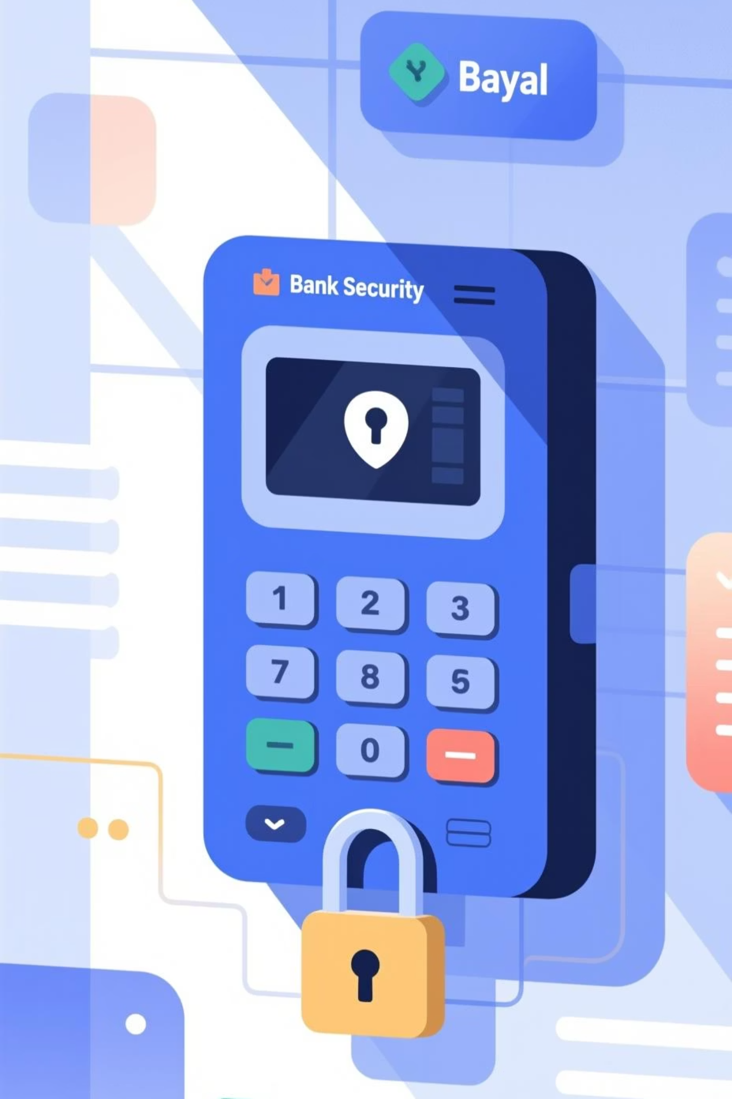
Security Lock System
Assembly Language Implementation in 8086

Slide 2

System Overview
Purpose
Core Features
A comprehensive security authentication system designed to protect employee access through ID verification and password management.
Employee ID validation
Password authentication
Account lockout protection
Password change capability

Slide 3



System Architecture
Data Segment
Stack Segment
Code Segment
Stores employee IDs, passwords, and attempt counters for 20 employees
Allocated 256 bytes (100h) for temporary data storage and subroutine calls
Contains main program logic, authentication routines, and helper procedures

Slide 4
Key Configuration Constants
20
3
0-15
Maximum Employees
Login Attempts
Password Range
System supports up to 20 employee accounts IDs
Three failed password attempts trigger automatic account lockout
Numeric passwords constrained to values between 0 and 15

Slide 5

Employee Data Structure
Employee ID Array
Password & Attempts
EmpTable stores 20 unique identifiers organized in three groups:
PassTable contains corresponding passwords (0-15) for each employee ID.
1001-1014: Department A
Attempts array tracks failed login counts, initialized to zero for all employees.
2001-2005: Department B
3001-3005: Department C

Slide 6




Authentication Flow
ID Verification
System prompts for employee ID and searches EmpTable using FindEmp procedure
Lockout Check
Validates current attempt count before allowing password entry
Password Validation
Compares entered password against PassTable entry for matched employee
Access Decision
Grants access on match, increments attempts on failure, locks after three attempts

Slide 7
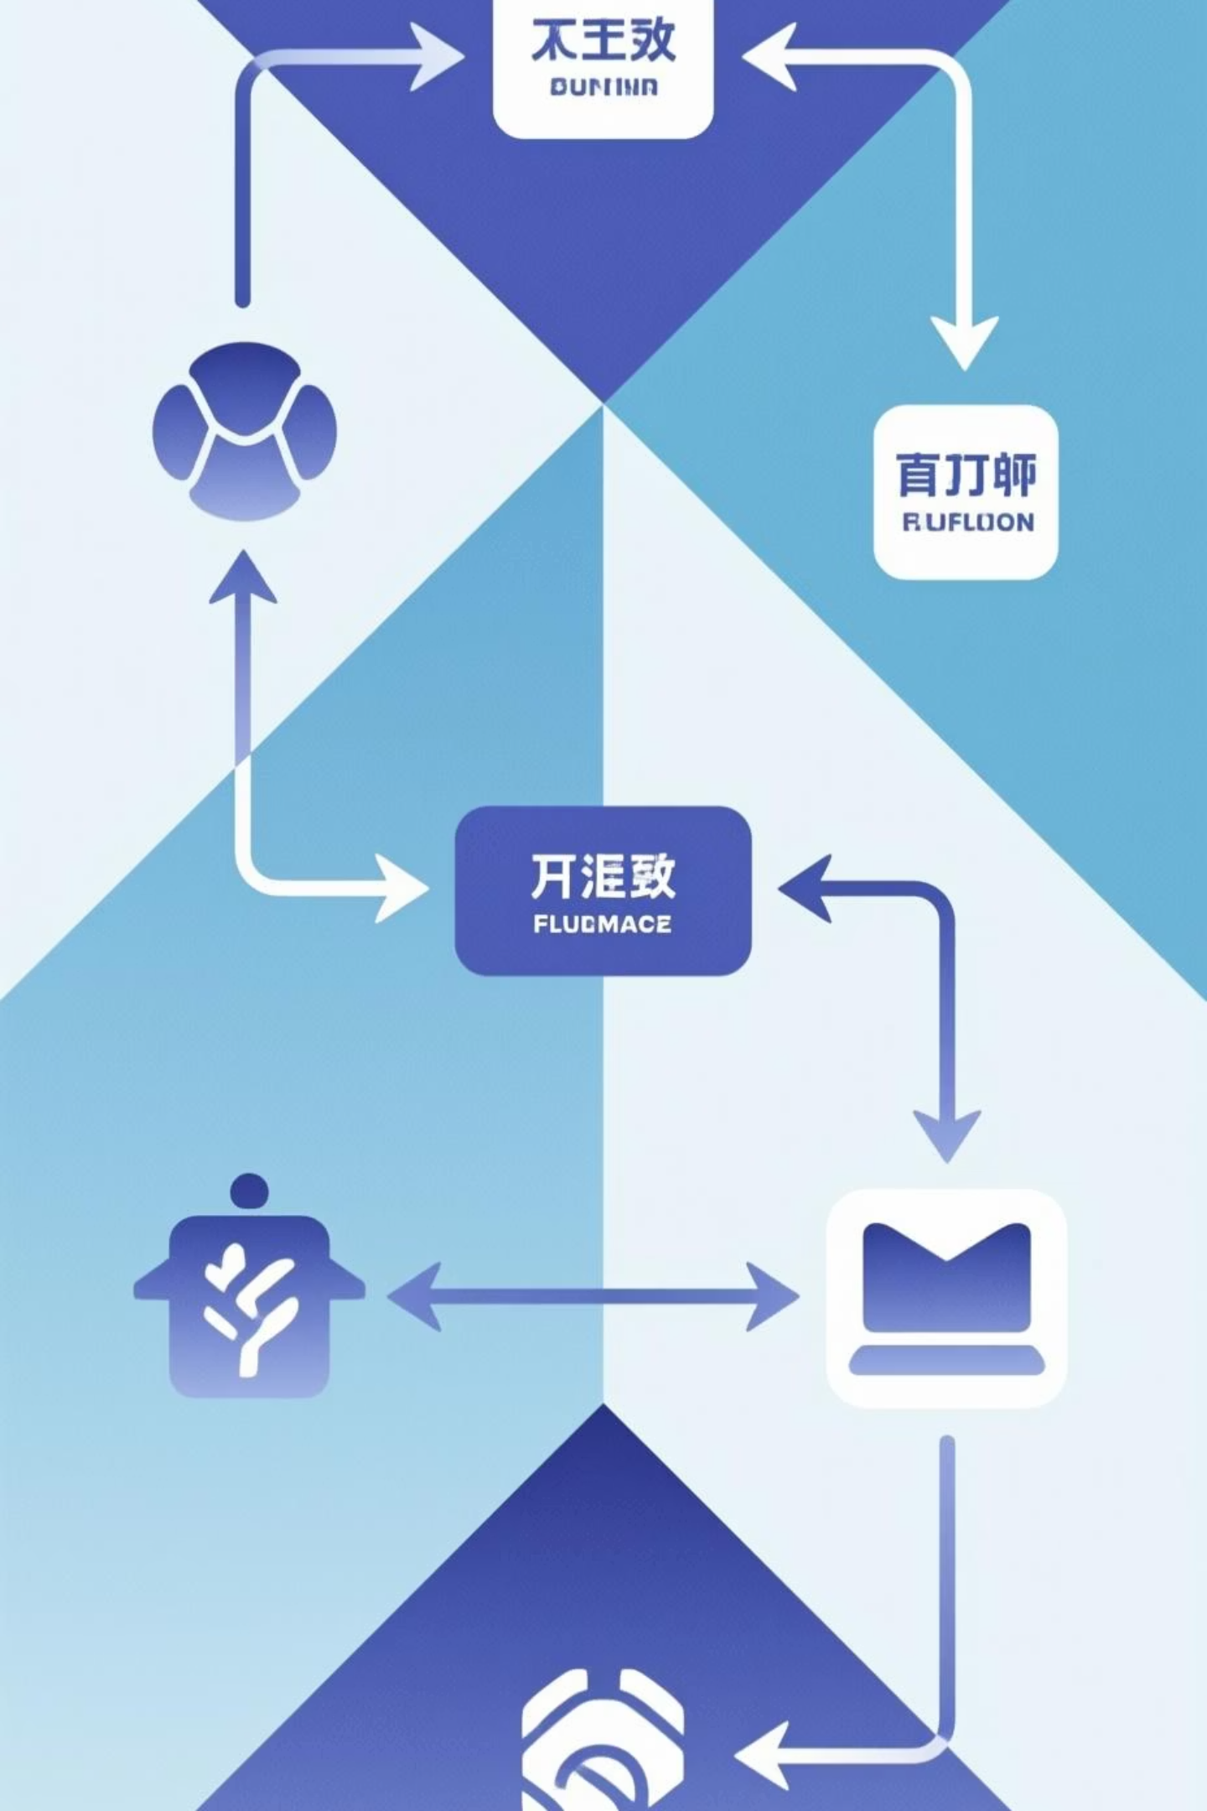
Critical Procedures
SCAN_NUM
1
Reads numeric input from keyboard and converts ASCII characters to binary value stored in CX register.
FindEmp
2
Searches EmpTable array for matching ID. Returns employee index in BX register or sets zero flag if not found.
Main Loop
3
Continuously displays menu, processes authentication requests, and handles password change operations until program termination.

Slide 8

Security Features
Multi-Layer Protection
Attempt Tracking: Individual counter per employee prevents brute force attacks
Automatic Lockout: Account becomes inaccessible after three failed attempts
Attempt Reset: Successful login clears failed attempt counter to zero
Persistent Lock: Locked accounts require manual reset (not implemented in basic version)

Slide 9

Password Management
1
2
Post-Login Prompt
User Confirmation
After successful authentication, system asks if user wants to change password
Accepts 'Y' or 'y' input to proceed with password change operation
3
4
New Password Entry
Update & Confirm
Prompts for new password within valid range (0-15) using SCAN_NUM procedure
Replaces old password in PassTable and displays confirmation message

Slide 10
Implementation Highlights
Memory Efficiency
DOS Integration
Modular Design
Compact data structures using byte arrays for passwords and word arrays for IDs minimize memory footprint.
Leverages INT 21h BIOS interrupts for keyboard input (AH=01h) and display output (AH=09h).
Separate procedures for input scanning and employee lookup promote code reusability and maintainability.

Slide 11

Thank You
Presented by:
B. Kaivalya - AP23110011311
D. Gopika - AP23110011571
Y.L. Maheswari - AP23110011590
Ch. Himakshi - AP23110011596
P. Durga Sravanthi - AP23110011597

